Slide 1





Railway Track Crack Detection System
Presented by :
Presented To :
Priyank Rathore (21DCS014)
Dr. Robin Singh Bhadoria
Assistant Professor
DEPARTMENT OF COMPUTER SCIENCE & ENGINEERING
NATIONAL INSTITUTE OF TECHNOLOGY HAMIRPUR

Slide 2
Table of Contents
Introduction
Theoretical Background
Proposed System
List of Components
System Block Diagram
Circuit Diagram
Working Principle
Benefits & Limitations
Conclusion

Slide 3
Introduction
Railways are one of the oldest and most used transportation systems.
Track-related failures like cracks can cause fatal accidents.
Railway accidents are often caused by:
Undetected cracks or breaks in the track
Delay in manual inspections
These issues are more dangerous in:
Remote areas
Nighttime operations
Need a smart, low-cost, real-time crack detection solution.

Slide 4
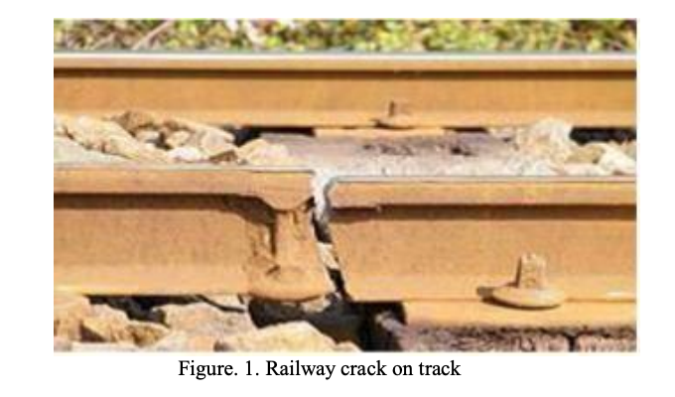
Project Objective
Detect cracks automatically using sensors.
Use Arduino to control detection and communication.
Send SMS alerts with location when a crack is found.
Ensure continuous monitoring regardless of time or location.

Slide 5
Theoretical Background
Cracks are small gaps or damages on the railway track.
If not detected early, they can lead to derailments.
Traditional detection methods:
Manual inspection (slow and risky)
Expensive advanced systems
Our system combines basic electronics and automation for smarter detection.

Slide 6
Overview of the Proposed System
A robotic vehicle moves on the track.
Ultrasonic sensor continuously checks rail level.
If a gap is found (distance > 2.5 cm):
Car stops
LED and buzzer activate
GPS detects location
GSM sends alert SMS

Slide 7
List of Components
Component | Description
Arduino UNO R3 | Controls all devices
Ultrasonic Sensor | Detects cracks
GSM SIM800L | Sends SMS alerts
GPS Module | Gets location
L298N Motor Driver | Controls DC motors
Component | Description
DC Motors | Moves the car
LED & Buzzer | Alert indicators
3.7V Batteries | Power supply

Slide 8
Arduino UNO R3
A microcontroller that reads sensor data and controls devices.
Used in DIY electronics projects.
Can be programmed using Arduino IDE.
In our project:
Controls sensors, motors, buzzer, LED.
Makes decisions based on sensor values.

Slide 9
Ultrasonic Sensor (HC-SR04)
Measures distance using sound waves.
Sends a pulse and waits for it to bounce back.
Time taken → calculates distance.
If rail gap > threshold → assumes crack present.

Slide 10
GPS Module
Global Positioning System module.
Reads current longitude and latitude.
Helps track the exact location of the crack.
Sends this info via GSM.

Slide 11
Motor Driver (L298N) & DC Motors
L298N receives control signals from Arduino.
Controls direction and speed of 2 DC motors.
Drives the prototype vehicle forward or stops it when a crack is found.

Slide 12
LED & Buzzer
LED lights up and buzzer rings when crack is detected.
These provide immediate visual and audio alerts.

Slide 13
Power Supply
Two 3.7V rechargeable lithium batteries.
Provides power to Arduino, motors, sensors.
Batteries are lightweight and can be recharged easily.

Slide 14
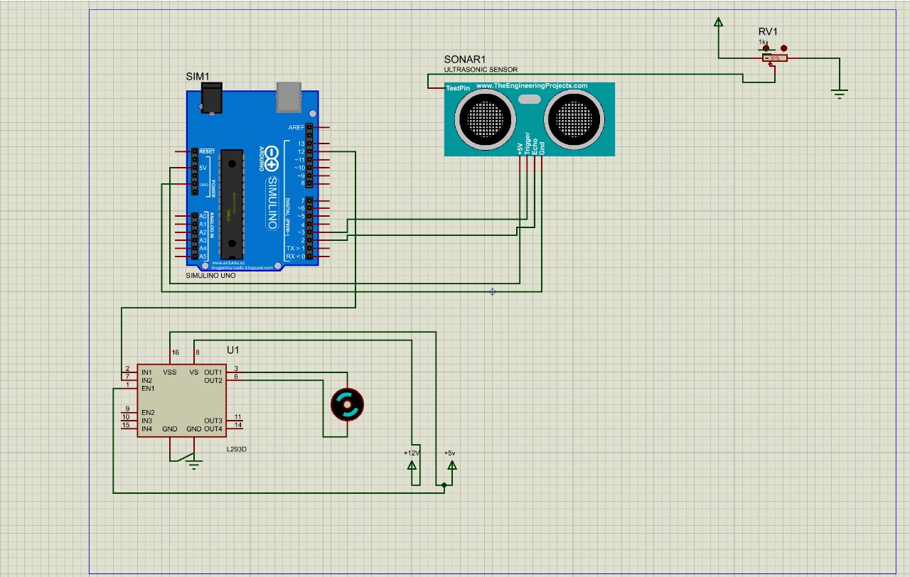
Circuit Diagram

Slide 15
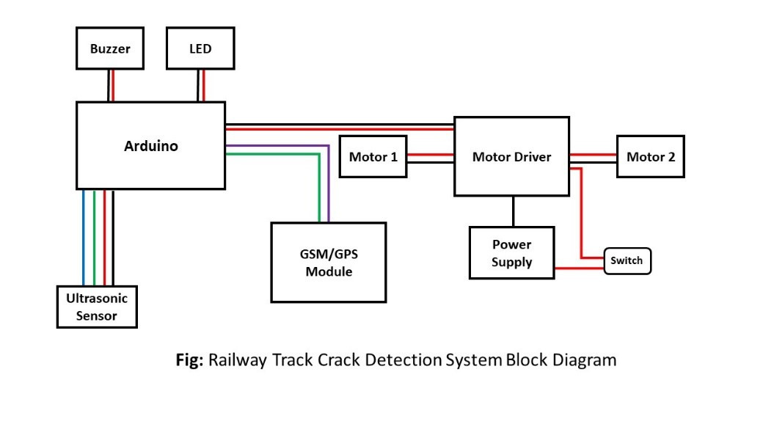
System Block Diagram

Slide 16
Working Principle
Car moves forward on the track.
Sensor checks distance between rails.
If the distance > 2.5 cm → crack detected.
LED & buzzer turn ON, motors stop, location is sent to station.
If distance is safe → car continues to move.

Slide 17
Benefits & Limitations
Benefits:
Real-time crack detection
Low cost
Useful day and night
Can reduce major accidents

Slide 18
Benefits & Limitations
Limitations:
Sensor protection in rain/dust
GSM signal availability
Battery drainage
Small prototype; needs large-scale upgrade

Slide 19
Conclusion
A smart way to monitor railway tracks.
Can be implemented for better safety and less manual work.
Future improvements:
Solar charging
AI-based crack pattern recognition
Cloud-based real-time tracking

Slide 20
References
A. S. Prasad, S. J, P. Shandilya and G. S, "Intelligent Railway Track Crack Detection System," 2024 8th International Conference on Computational System and Information Technology for Sustainable Solutions (CSITSS), Bengaluru, India, 2024, pp. 1-5, doi: 10.1109/CSITSS64042.2024.10816777.
Automatic Railway Gate Crossing Control and Track Crack Detection System Using IoT Y. Maheswar , J. Hemalatha , G. Surya , G. Suryanarayana Reddy , D. Bhargav (2024). https://ijatem.com/wp-content/uploads/2024/05/IJATEM-24_004.pdf
I. Devulapalli, A. V. Vennelakanti and R. Sallakunta, "Real-Time Railway Track Fault Detection and Environmental Monitoring System Using Arduino and GSM," 2024 4th International Conference on Technological Advancements in Computational Sciences (ICTACS), Tashkent, Uzbekistan, 2024, pp. 1410-1415, doi: 10.1109/ICTACS62700.2024.10840621.

Slide 21
THANK
YOU

